Slide 1

AASD 4004
Machine Learning - II
Applied AI Solutions Developer Program

Slide 2
Module 14 Introduction to Audio Processing
Vejey Gandyer

Slide 3
Agenda
Audio Processing
Why
Basic Concepts
Tools for Audio Processing
Pyaudio
Librosa
Pydub
Applications

Slide 4
Audio Processing
What is it?

Slide 5
Audio Processing
Audio Processing means changing the characteristics of an audio signal in some way

Slide 6
Why

Slide 7
Why to process Audio?
To enhance audio
To separate channels
To create new sounds
To store sounds

Slide 8
Basic Concepts

Slide 9
Basic Concepts
Frequency
Sampling Rate
Sine wave
Amplitude
Discrete Fourier Transform - Calculates which frequencies are present, Converts time domain signal to a frequency domain
Noise Filtering

Slide 10
Sound
Sound is a travelling vibration
2 basic attributes
Amplitude (loudness)
Frequency (measure of wave's vibration per unit time)

Slide 11
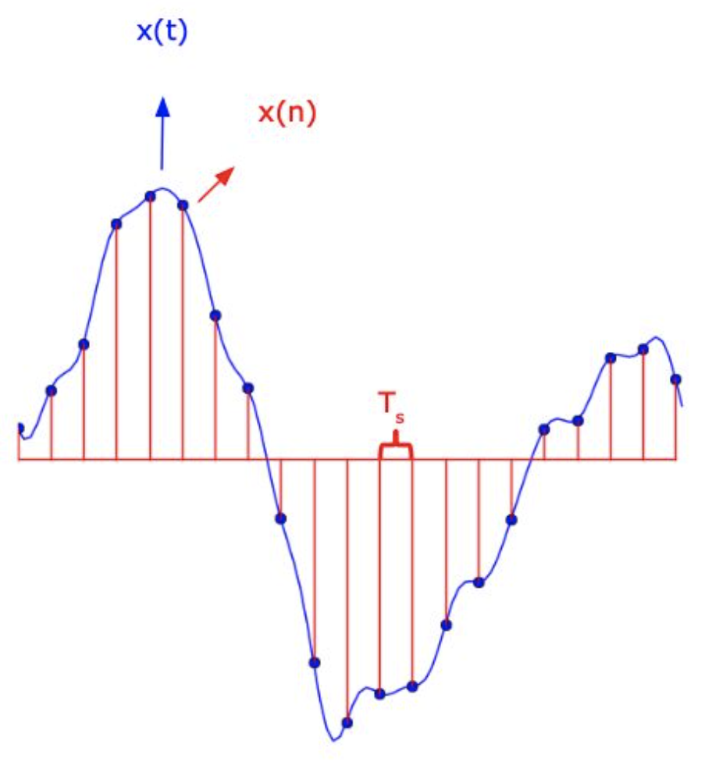
Analog to Digital Conversion
Sampling - Convert the time-varying continuous signal x(t) to a discrete sequence x(n) of real numbers
Sampling period T_{s} - Interval between successive discrete samples
Sampling frequency - f_{s} = 1 / T_{s}
Quantization - Replacing each real number of the sequence of samples with an approximation from a finite set of discrete values

Slide 12
Sine wave
Sine wave formula
y(t) = A * sin(2 * pi * f * t)

Slide 13
Frequency
Number of times a sine wave repeats a second

Slide 14
Sampling rate
Real world signals are analog signals
In digitizing it, converting analog to digital, takes a sample at defined intervals
Eg: 48000

Slide 15
Amplitude
Height of the sine wave
y(t) = A * sin(2 * pi * f * t)

Slide 16
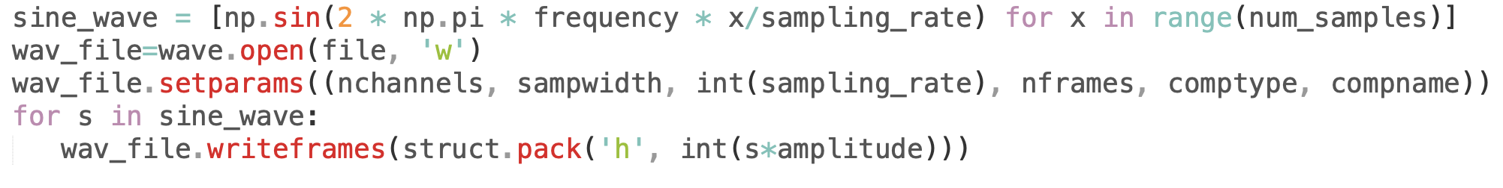
Let's create a sine wave
Create a sine wave
Write the sine wave in an audio file (.wav)

Slide 17
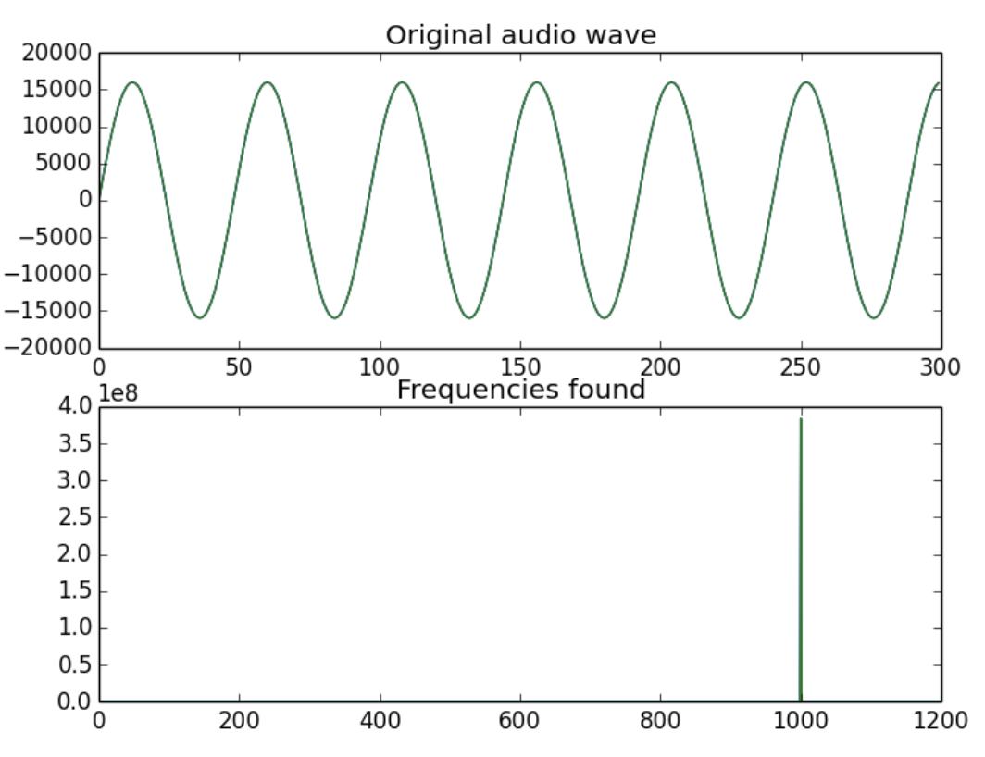
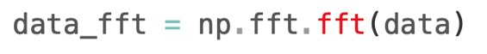
Discrete Fourier Transform (DFT)
Identifies what are the frequencies present in the signal

Slide 18
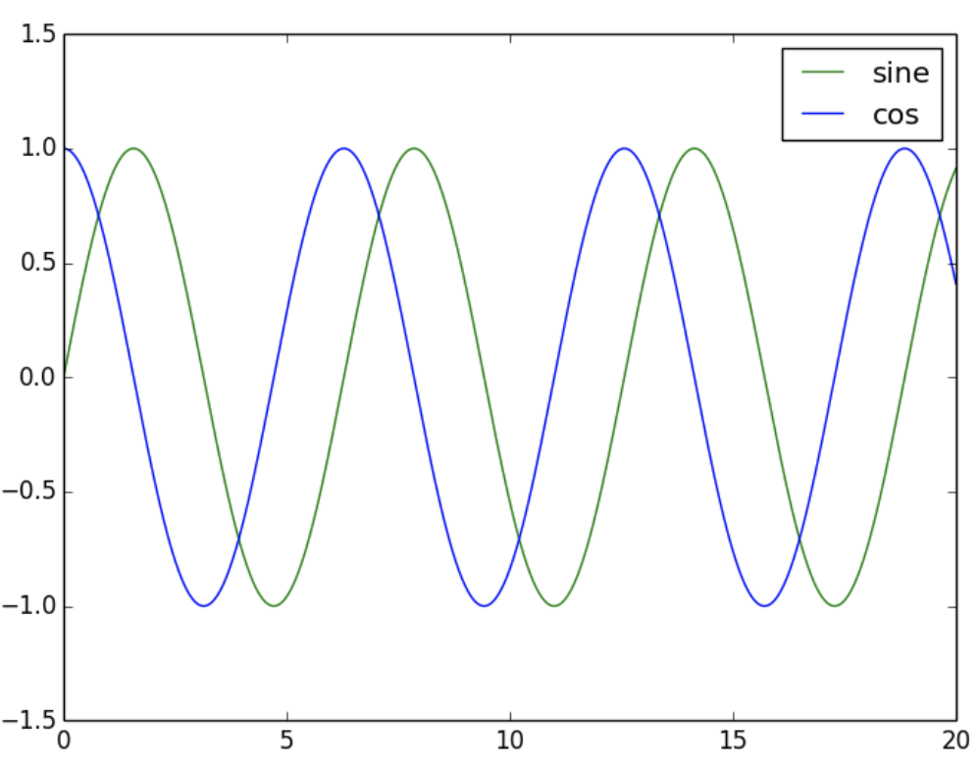
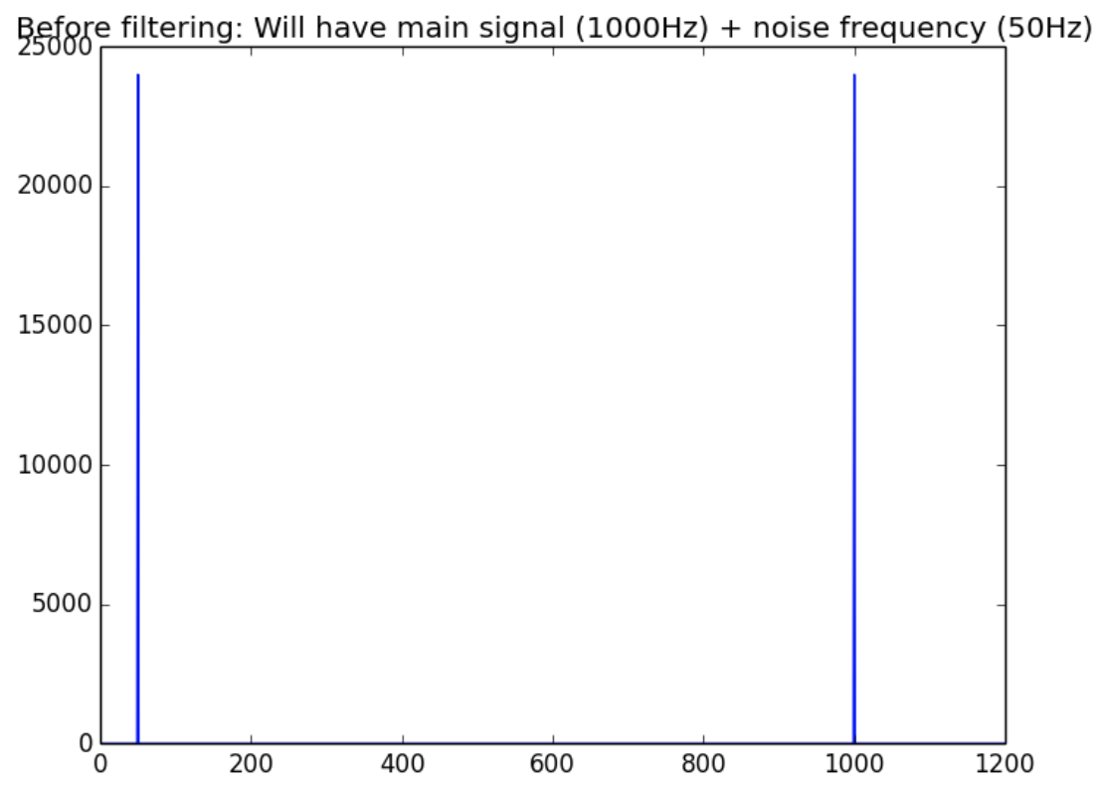
Discrete Fourier Transform (DFT)
Identifies what are the frequencies present in the signal

Slide 19
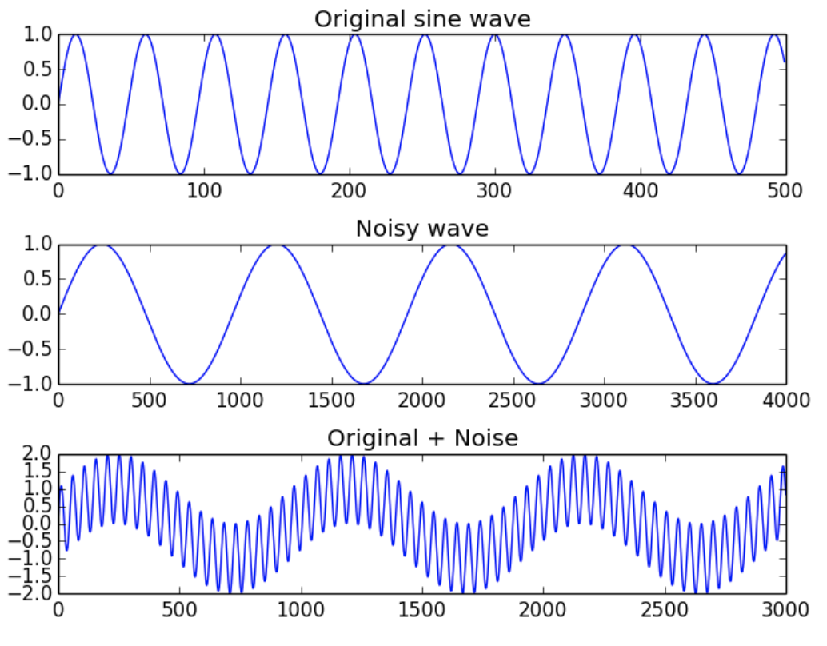
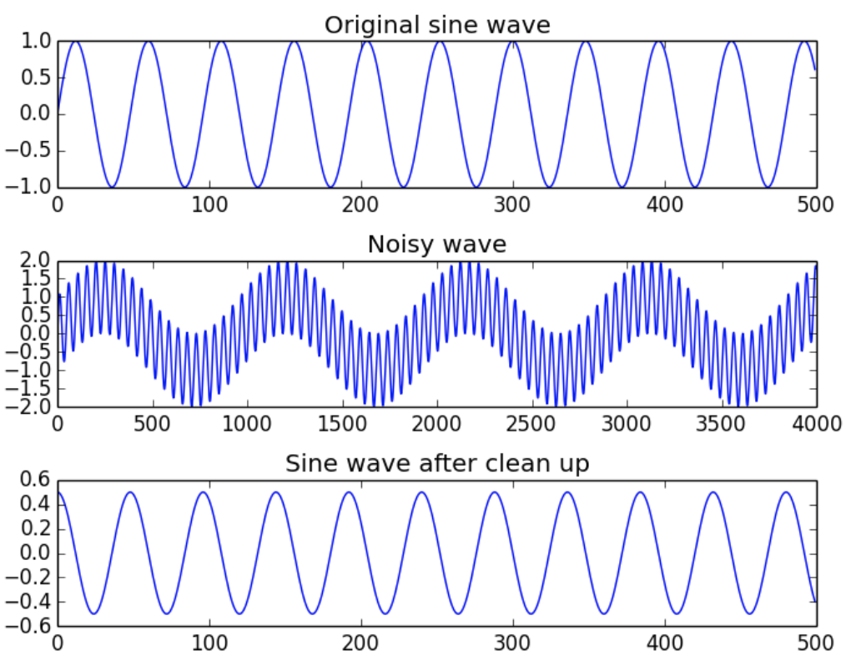
Cleaning a noisy signal (sine wave)
Generate a sine wave (signal)
Add noise
Filter the noise

Slide 20
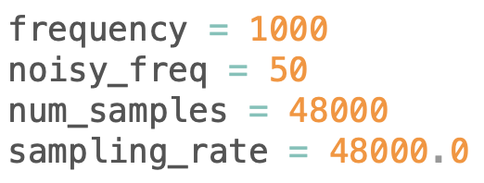
Cleaning a noisy signal (sine wave)
Generate a sine wave (signal)
Add noise
Filter the noise

Slide 21
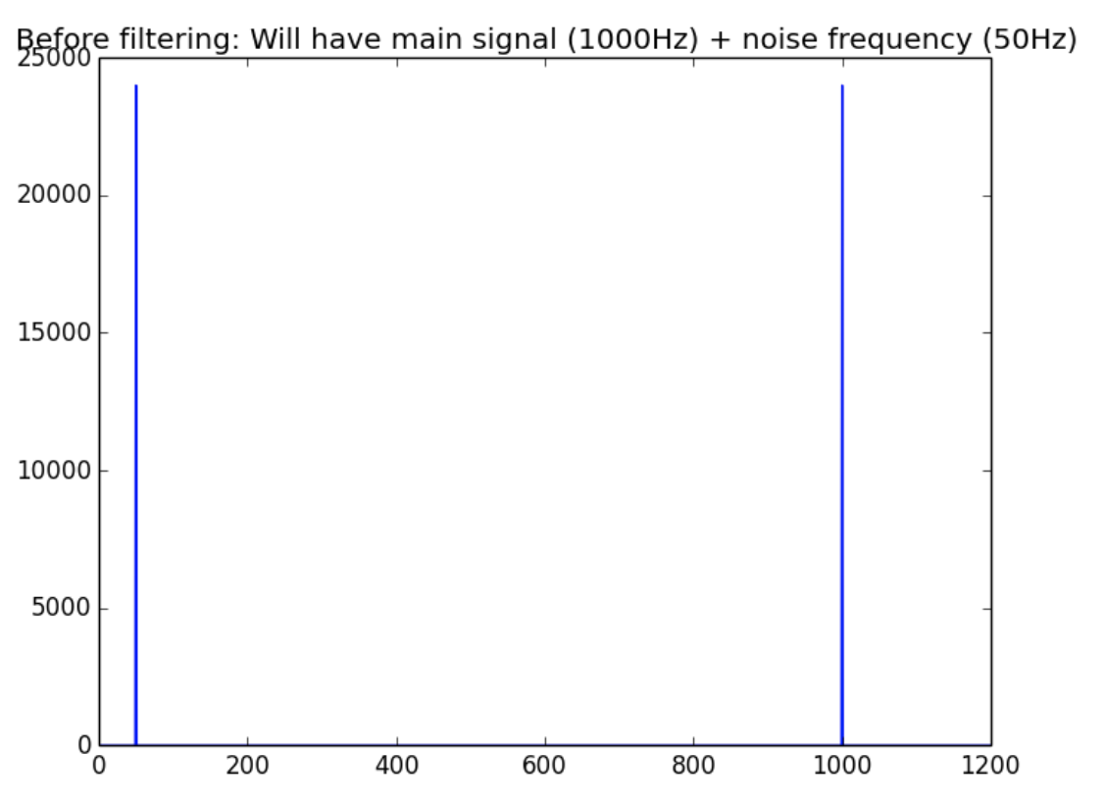
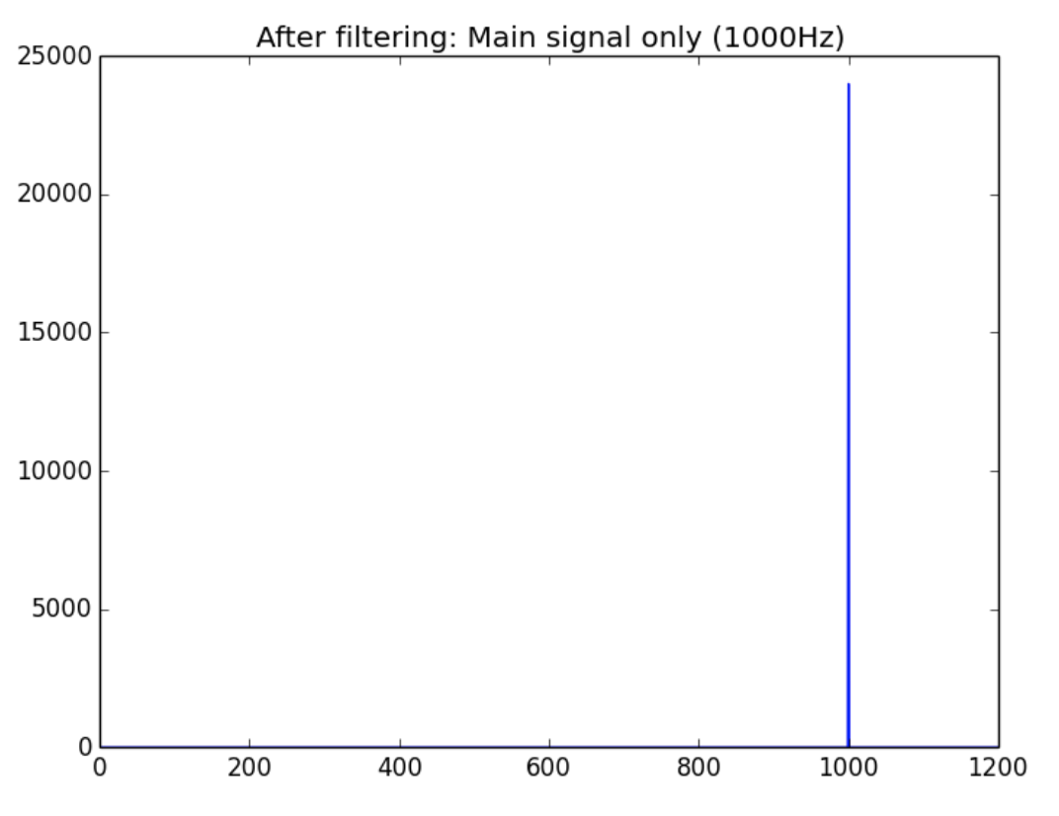
Cleaning a noisy signal (sine wave)
Noisy signal
Clean signal

Slide 22
Tools for Audio Processing

Slide 23
Tools
ffmpeg/libav - Handling multimedia files and streams
sox - Swiss Army knife of sound processing programs
audacity - Editing and playback software
pyAudioAnalysis - IO, advanced feature extraction and signal analysis
librosa - Nice library for audio analysis
pydub - Library for audio processing

Slide 24
Pydub
https://github.com/jiaaro/pydub

Slide 25
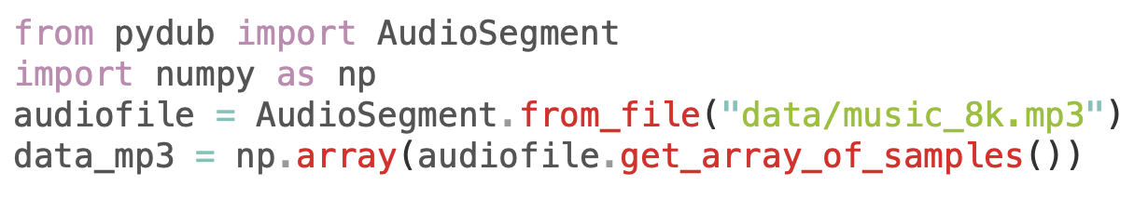
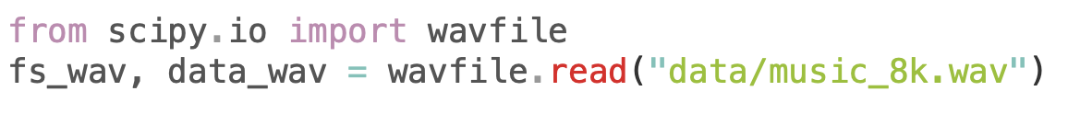
Loading a wav file
pydub
scipy

Slide 26
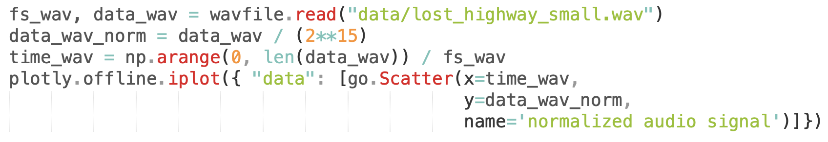
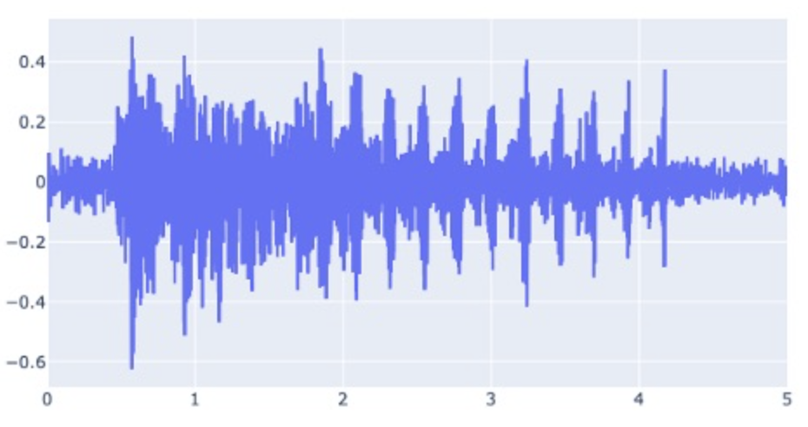
Normalization
Makes the signal values independent to the sample resolution
Squish the values of an audio signal in the (-1, 1) by dividing by 2¹⁵

Slide 27
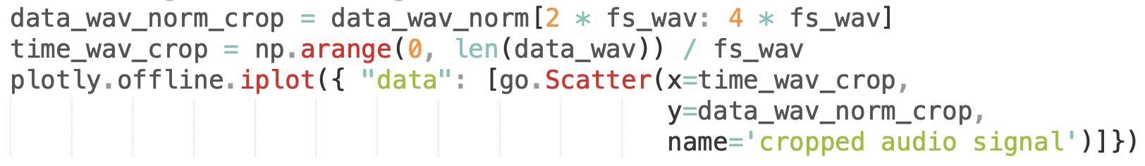
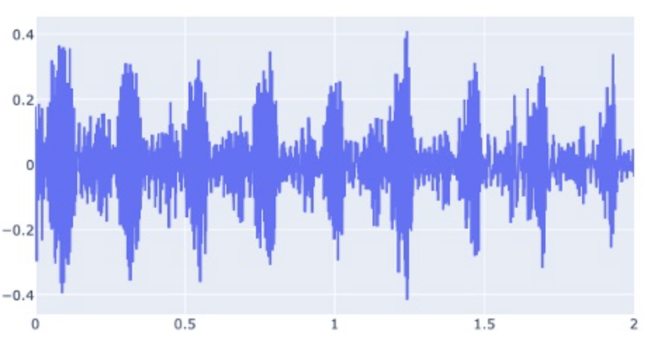
Trim/Clip/Segment audio clips
Clips the audio file portions by referring to the respective indices in the numpy array
Seconds need to be multiplied by the sampling frequency

Slide 28
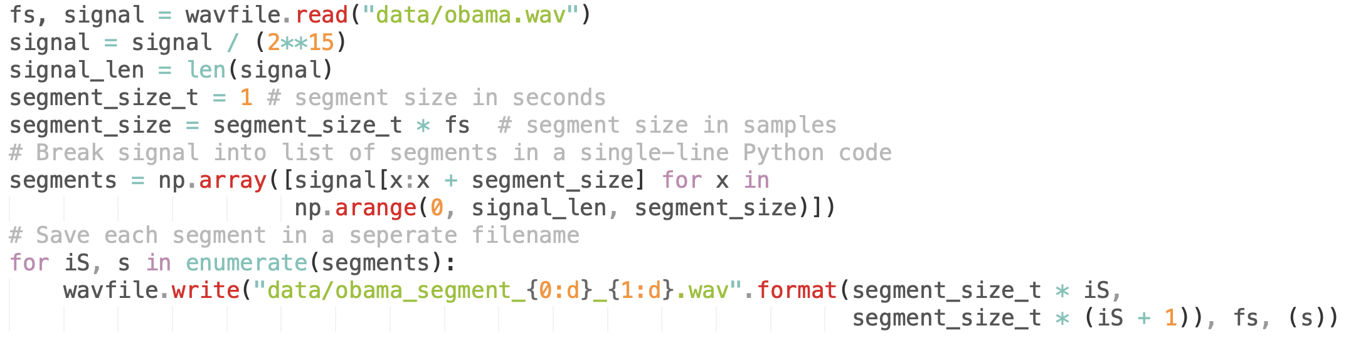
Split audio into fixed-size segments

Slide 29
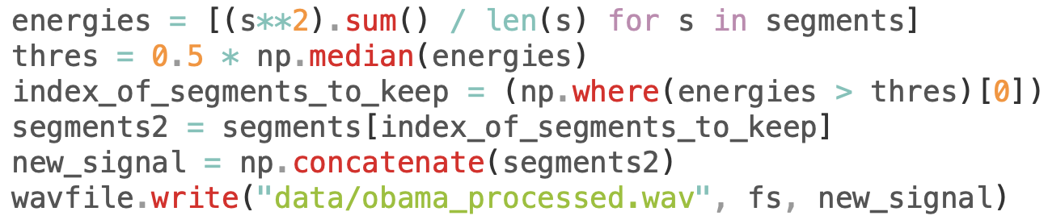
Remove silent segments from audio
Computes energy as the sum of squares of the samples
Calculates a threshold as 50% of the median energy value
Keeps the segments whose energy are above the set threshold

Slide 30
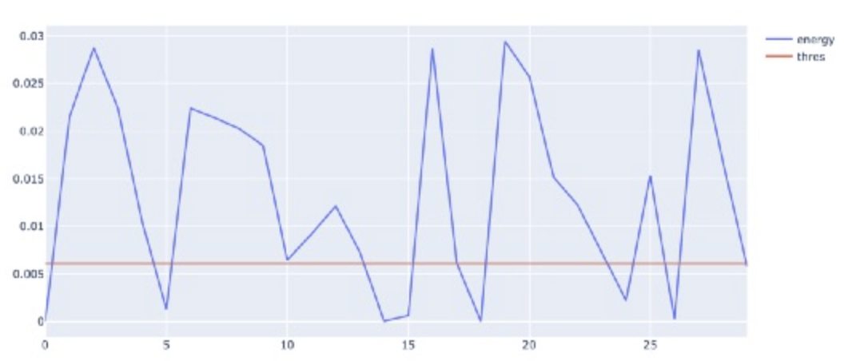
Remove silent segments from audio
Keeps the segments whose energy are above the set threshold

Slide 31

Remove silent segments from audio
Original
Processed

Slide 32
PyAudio

Slide 33
PyAudio - Installation
Brew
brew install portaudio
PyPI
pip install pyaudio
Conda
conda install –c conda-forge pyaudio

Slide 34
Recording & Visualizing Frequencies
Goals:
Capture sound by a microphone in real-time
Visualize the frequencies present in real-time

Slide 35
Recording & Visualizing Frequencies
Capture the sound in fixed-size segments (200 ms)
For each segment, plot the frequency distribution in real-time
Compute magnitude X of FFT of the segment and frequency values (in Hz) in a separate array freqs
Downsample X and freqs, so that we keep very few frequency coefficients to visualize
Compute total segment's energy (to normalize against the maximum width of the frequency visualization)
Bar Plot downsampled frequency energies X for all frequencies

Slide 36
Recording & Visualizing Frequencies
Capture the sound in fixed-size segments (200 ms)

Slide 37
Recording & Visualizing Frequencies
Compute magnitude X of FFT of the segment and frequency values (in Hz) in a separate array freqs

Slide 38
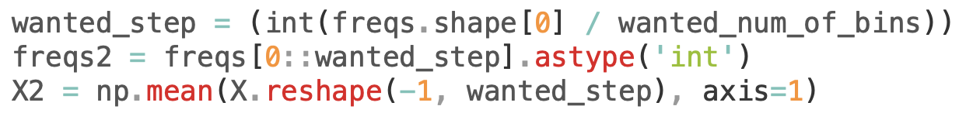
Recording & Visualizing Frequencies
Downsample X and freqs, so that we keep very few frequency coefficients to visualize

Slide 39
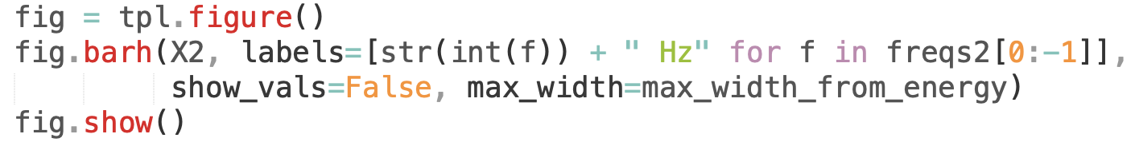
Recording & Visualizing Frequencies
Bar Plot downsampled frequency energies X for all frequencies

Slide 40
Recording & Visualizing Frequencies
Demo

Slide 41
Librosa
https://librosa.org/doc/latest/index.html

Slide 42
Librosa - Installation
PyPI
pip install librosa
Conda
conda install –c conda-forge librosa
Source
tar xzf librosa-VERSION.tar.gz cd librosa-VERSION/ python setup.py install

Slide 43
Librosa - Submodules
beat - Estimating tempo and detecting beat events
Core - Load audio, compute spectrograms and other analysis
Decompose - Harmonic-percussive source separation (HPSS)
Display - display and visualization routines
Effects - Pitch Shifting, Time-stretching
Feature - Chromagrams, Mel Spectrogram, MFCC
Filters - Filter-bank generation (Chroma, pseudo-CQT, CQT)
Onset - Onset detection and Onset strength computation

Slide 44
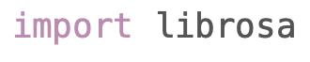
Librosa - Quick Example (Beats)
Importing library
Get the audio file
Load the audio file
Beat tracker
Tempo
Frame numbers into
timestamps

Slide 45
Beats Generator

Slide 46
Beats Generator - Tempo tracking
Task of automatically estimating a song's temp (in beats per minute) directly from the signal using librosa library
Input: Mono audio file
Output: Stereo file
Left channel: original song
Right channel: "beep" sound mimicing the tempo of the song

Slide 47
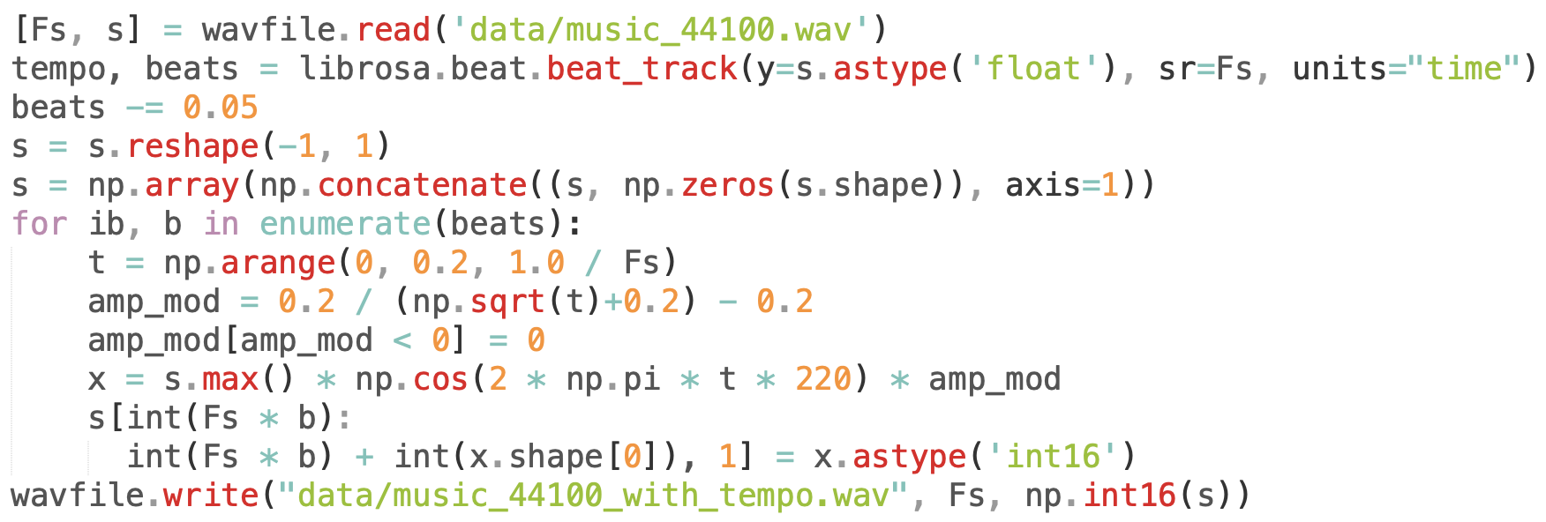
Beats Generator - Tempo tracking

Slide 48
Beats Generator
Sample 1
Sample 2

Slide 49
PyAudioAnalysis
https://github.com/tyiannak/pyAudioAnalysis

Slide 50
PyAudioAnalysis - Installation
PyPI
pip install PyAudioAnalysis
Conda
conda install –c conda-forge PyAudioAnalysis
Source
git clone https://github.com/tyiannak/pyAudioAnalysis.git
cd pyAudioAnalysis
pip install –r ./requirements.txt

Slide 51
Further Reading
Basic Concepts in Audio Processing
https://www.pythonforengineers.com/audio-and-digital-signal-processingdsp-in-python/
https://www.ee.iitb.ac.in/student/~daplab/publications/chapter9-prao.pdf
Librosa
https://librosa.org/doc/latest/index.html
PyAudioAnalysis
https://github.com/tyiannak/pyAudioAnalysis
Pydub
https://github.com/jiaaro/pydub

